Slide 1

LAIBA KHALID(BSEF23M002)
M.UMER FAROOQ(BSEF23M004)
M.FAROOQ(BSEF23M029)
ROHAN RAJ SINGH(BSEF23M039)
TALAL AHMAD(BSEF23M044)

Slide 2
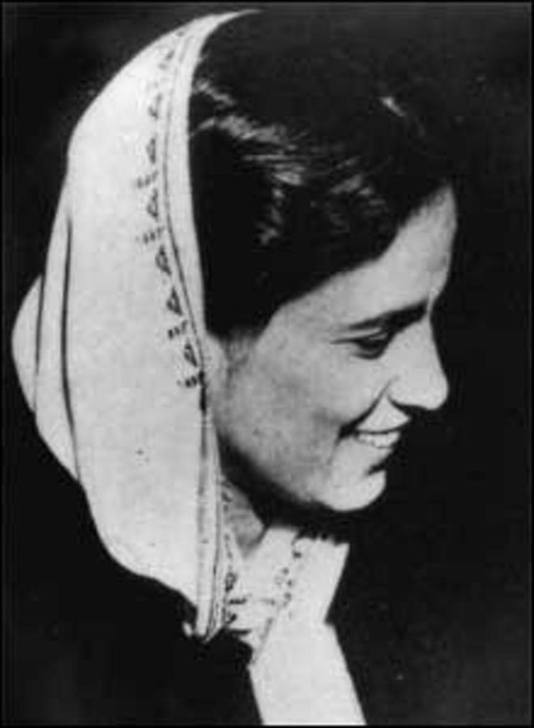
INTRODUCTION
Begum Salma Tassaduq Hussain played a vital role in the freedom movement during the early 20th century. As a dedicated social worker, political activist, and advocate for women's rights, she worked tirelessly alongside other prominent leaders to challenge British rule and shape the future of India.
EARLY LIFE
Begum Salma Tassaduq Hussain, born in 1908, hailed from Rawalpindi's scholarly family. Marrying at fifteen, she balanced education with domestic duties, attaining a BA from Punjab University. Inspired by Quaid-e-Azam, she embarked on a political journey, guided by his mentorship. Her marriage to Dr. Tassaduq Hussain Khalid, a prominent Urdu poet, enriched her literary legacy. She stands as a fortunate political figure mentored by Quaid-e-Azam, leaving an indelible mark on Pakistan's national landscape.

Slide 3

POLITICAL CAREER
Political Career: She was part of the Punjab Provincial Women Subcommittee and was elected as one of its secretaries in 1940.
Muslim League: She was nominated to the Council of the All India Muslim League in 1941 and served the Central Subcommittee of the All India Muslim League in 1943.
Elections: She contested the 1946 elections on the Muslim League ticket for the Punjab Provincial Assembly seat from inner Lahore and won.
Bihar Riots: She provided refuge to countless displaced individuals during the Bihar riots.
Leadership: She represented the Muslim League at the Conference of Kisan Sabha.
Women's Participation: She was an active member of the Women's League and advocated for women's participation in the political arena.
Religious Freedom: She believed in the necessity of an independent homeland for Muslims to practice their faith and uphold traditions.

Slide 4

Contributions of Begum Salma Tassaduq Hussain for the independence of Pakistan
Begum Salma Tassaduq Hussain was an audacious campaigner for the Pakistan Movement, using her multifaceted identity as a talented writer, poet, and entrepreneur to further the cause
She actively contributed to the Punjab Provincial Women's Subcommittee and the Bengal Relief Fund Committee.
In 1946, she secured a seat for Muslim women in the Punjab Provincial Legislature elections, a pivotal moment in the quest for a separate homeland.
Dedicated to humanitarian causes, Begum Tassaduq played a pivotal role during the Bihar riots, offering refuge to countless refugees.
She represented the Muslim League at the Conference of Kisan Sabha in Jalundhar and even chaired a session, showcasing her political acumen.
She was a prominent member of the Women's League, epitomizing the political awareness, education, and activism that characterized Muslim women during the Pakistan Movement.

Slide 5
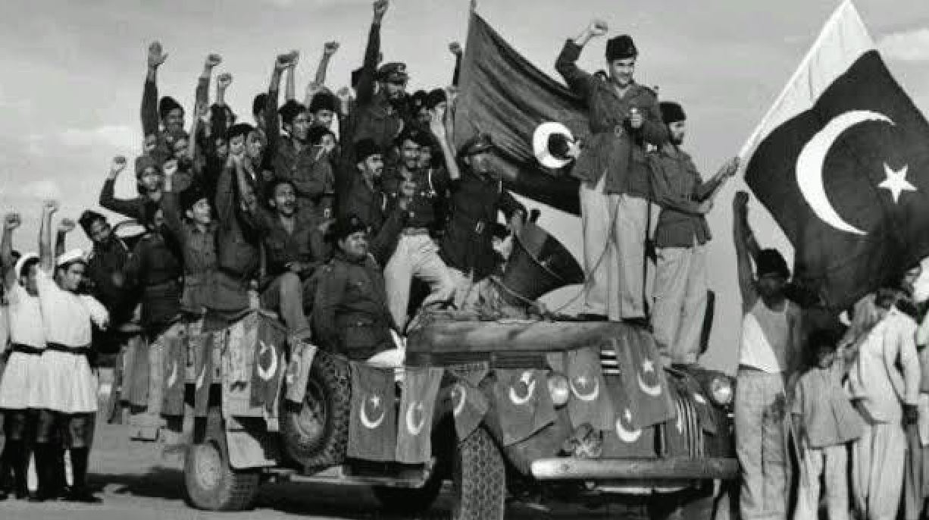
CHALLENGES FACED
Begum Salma Tassaduq Hussain faced several challenges in her political journey, including:
1-Gender bias and stereotypes: As a woman in a male-dominated political landscape, she encountered gender-based discrimination and skepticism about her abilities.
2- Resistance from conservative elements: Her advocacy for women's rights and empowerment faced opposition from conservative forces within the Muslim League and society at large.
3- Balancing family and politics: As a wife and mother, she had to navigate the demands of family life while pursuing her political passions.
4-Limited resources and support: As a woman in politics, she often had limited access to resources, funding, and networks compared to her male counterparts.
5- Personal sacrifices: Her political work required significant personal sacrifices, including time away from family and exposure to political turmoil.
6- Navigating complex political dynamics: She had to navigate the intricate web of political alliances, rivalries, and ideologies within the Muslim League and broader political landscape.
7- Overcoming societal expectations: She faced pressure to conform to traditional gender roles and expectations, which could have limited her political ambitions.
8- Dealing with opposition and criticism: As a prominent figure, she faced criticism and opposition from political opponents, which could be challenging to navigate.

Slide 6
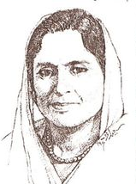
LAGACY
1- Begum Salma Tassaduq Hussain's tireless efforts and unwavering dedication have left an indelible mark on the history of women's rights in Pakistan.
2-She broke barriers and challenged societal norms, paving the way for countless women to enter the political arena and assert their voices. - Her advocacy for gender equality and her role in the women's movement have inspired generations of women to actively participate in politics and public life.
3 - Today, her legacy continues to influence and shape Pakistan's social and political landscape, reminding us of the power of resilience and determination.
"Begum Salma Tassaduq Hussain's legacy is a testament to the power of courage and determination."
- Benazir Bhutto

Slide 7

CONCLUSION
Begum Salma Tassaduq Hussain's contributions to Pakistan's freedom movement and women's rights are enduring. Her courage, leadership, and dedication inspire us to strive for a more just society. Let's draw inspiration from her example and commit to continuing her work. By honoring her legacy, we can build a better future, ensuring her values endure in our efforts for progress and equality. Her story reminds us that the fight for freedom and equality is ongoing; it's our responsibility to carry her vision forward.

Slide 8
Thank you

